Slide 1

Data Driven Coaching
Safely turning team data into coaching insights (Troy Magennis)
@t_magennis troy.magennis@FocusedObjective.com

Slide 2

Data is E V I L
Notes:
Data isn’t evil, people are evil. Sure, sometimes data can highlight something we would rather not be true, but this doesn’t make it wrong to capture and analyze data in proper ways.

Slide 3
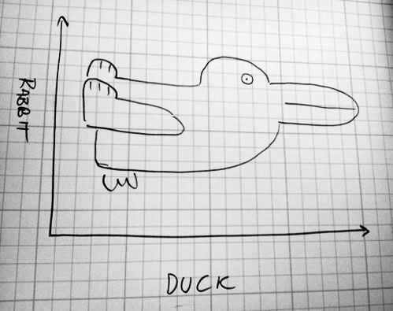
Notes:
Interpreting data we capture for process improvement and coaching teams is hard. Sometimes you think you understand what you see, only to have that taken away from you. Sometimes, If it walks like a duck and quacks like a duck, it could still be a rabbit. Perspective and context matters.

Slide 4
Data Driven Coaching Goals
1. Help teams safely identify ways they can improve future outcomes by detecting things that are about to (or have) gone adversely with ambitions to lessen this in the future.
2. Help teams avoid over emphasizing one aspect of successful development and delivery.

Slide 5
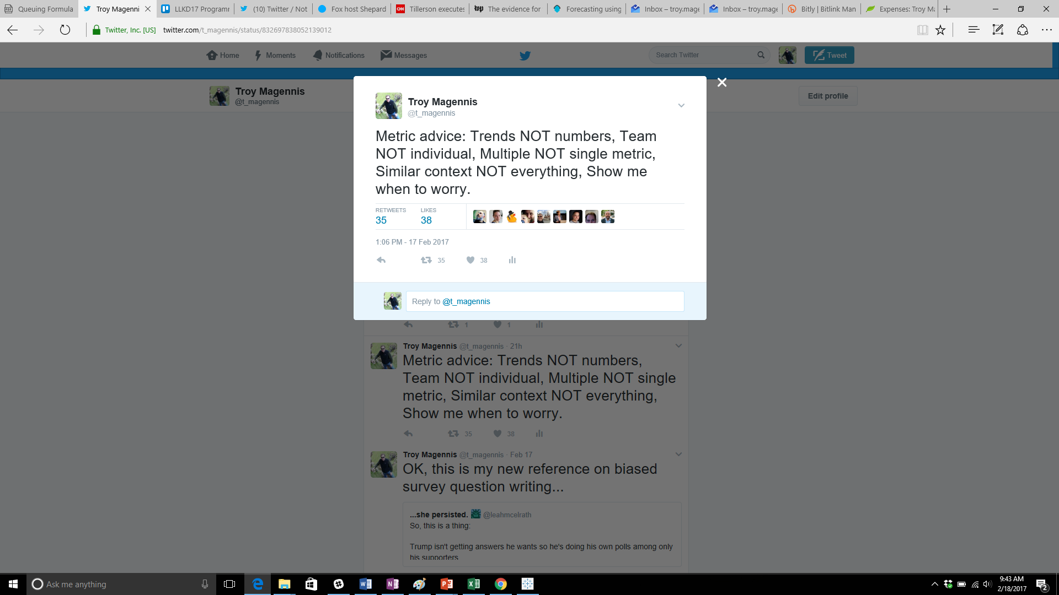
TL;DR Takeaways

Slide 6
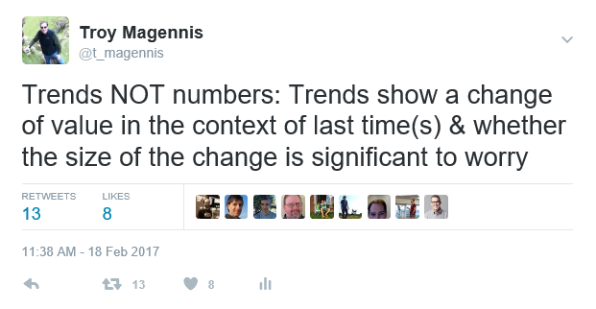

Slide 7
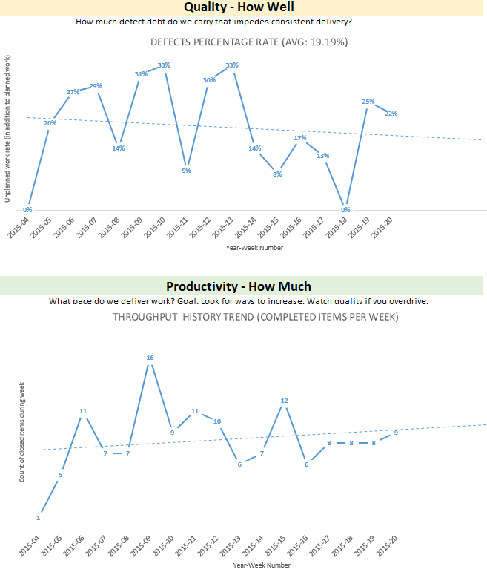
How to get focus on trends?
No Y-Axis
Make numbers 8pt Font (bosses can’t read it, millennials won’t)
Connect points with a line to “visually trend”
Add a trend line
Project trend line forward
Get this: Team Dashboard v3.xlsx from Bit.Ly/SimResources (case sensitive)
In the spreadsheets folder

Slide 8
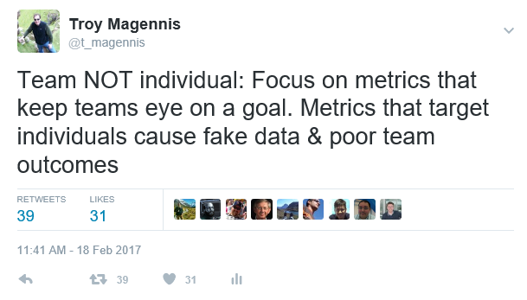
Individual examples:
Bug for each developer by name
Points per developer

Slide 9
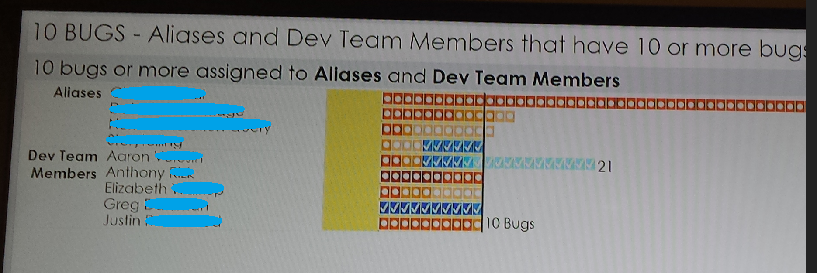

Slide 10

Notes:
Forecasting is about setting better expectations about what reality will eventually unfold.
Expectations are subject to all manner of biases, wishful thinking and incomplete logic. Out job in forecasting is to narrow that gap, better align forecast to reality.
Its about demonstrating we understand the wholistic delivery system well enough that we can make better, more informed decisions earlier.

Slide 11

“Remember that all models are wrong; the practical question is how wrong do they have to be to not be useful.”
Statistician, George Box

Slide 12
Better than intuition or whatever you do now.
Not perfect. Not exact. Not always right.

Slide 13
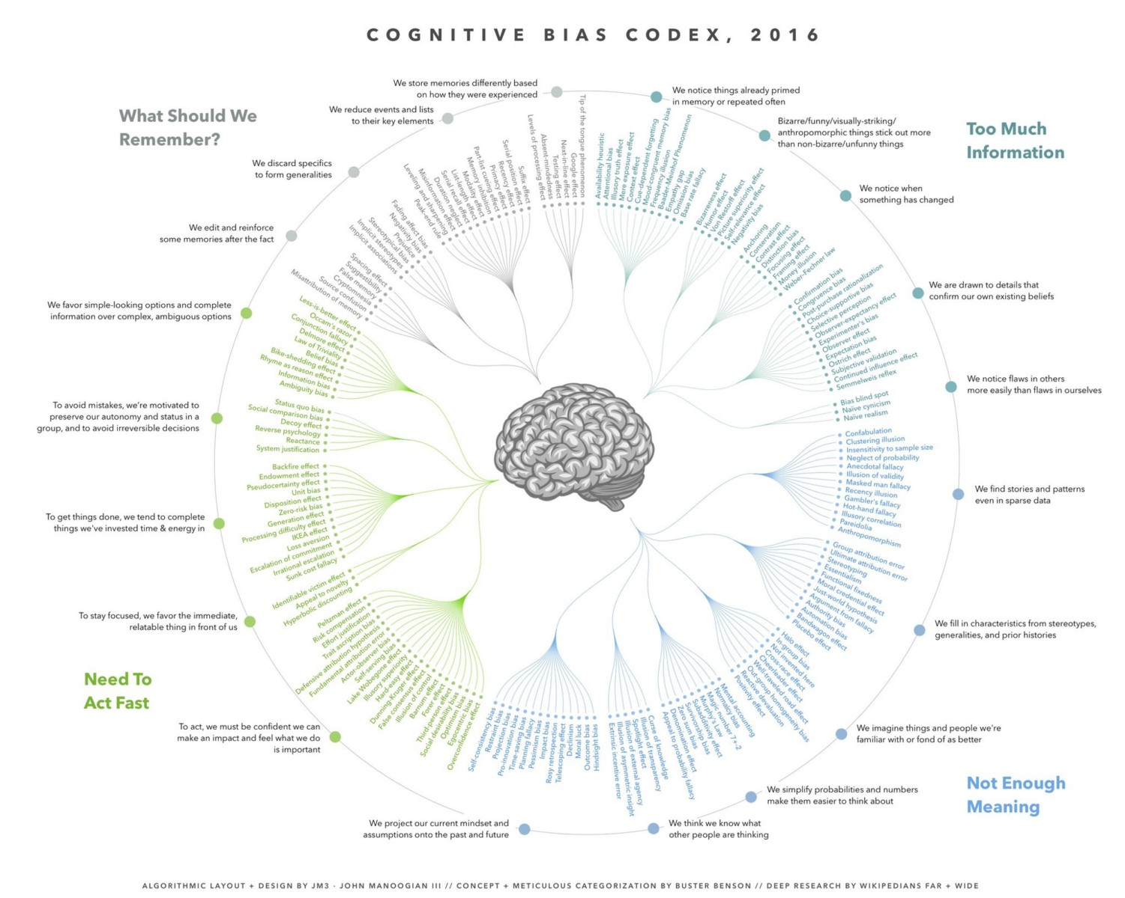
http://ritholtz.com/2016/09/cognitive-bias-codex/

Slide 14
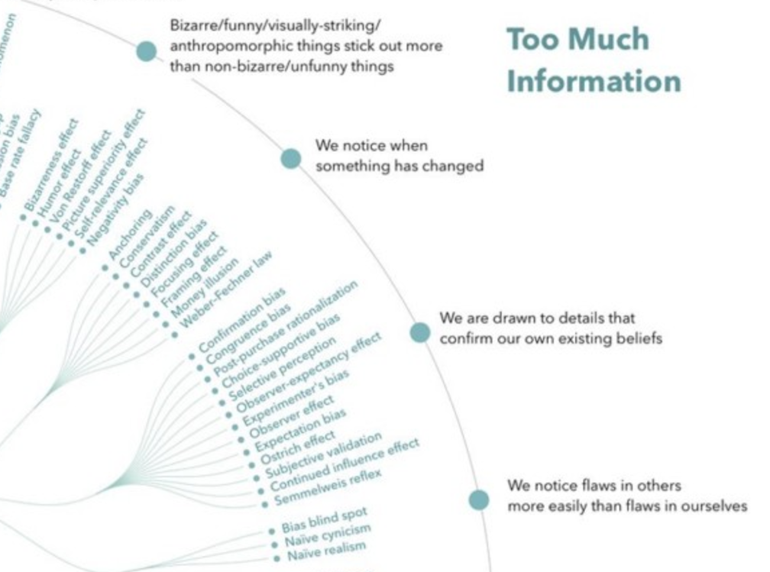
http://ritholtz.com/2016/09/cognitive-bias-codex/

Slide 15
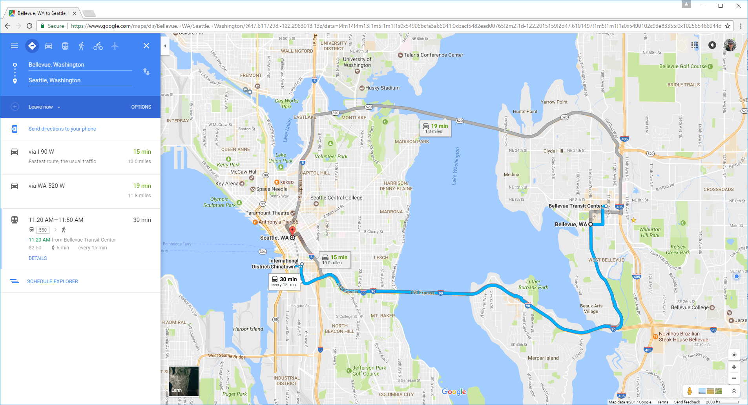
Forecasting
How Big
How Long
How Much
Fails
Q and A
Multiple Options – NOT one…
Duration not ETA until commitment…
Continuously updated once started…
Notes:
Google Maps emerged about 10 years ago. It’s now pretty ubiquitous when we want to travel in unfamiliar areas that we se our phones to navigate. It has save my and many other marriages I suspect.
Being around for 10 years means its undergone a lot of refinement, and is a pretty good reference to learn how to present forecass.
There is some subtleties that we can easily use in forecasting software and IT projects.
First off, it doesn’t show just one option, it shown many. Here, two driving alternatives and a public transport alternative. It keeps the human in the decision loop. It presents options, even highlighting the fastest one, but it clearly shows the others in case there is some compelling reason they are useful.
Second, it doesn’t give an arrival time yet. It gives duration. Obviously, it doesn’t yet know when we are leaving home.
Thirdly, once we do commit to one of the options, it gives us continuously updated arrival time information. It incorporates the latest traffic issues based on traffic flow ahead of us and even suggests alternative routes if its original turns out to be less ideal.

Slide 16

Contrast Google Maps to Software Estimates
Forecasting
How Big
How Long
How Much
Fails
Q and A
If you currently…
Consider doing…
Give one forecast even though multiple approaches considered
Give a calendar date for undefined “complete” & “start”
If the original date is in doubt we find out near the end
Appear on-time until we are not. Measure progress from start.
Give multiple options of investment and implementation
Give a duration and define what started & complete means
If the original date is in doubt, know earlier and react faster
Report remaining time to deliver not time since started
Notes:
So, lets incorporate that into our world.
Lets NOT give a single answer, lets show the options we have considered in case they offer some advantage we haven’t considered.
Lets NOT give a calendar delivery date until the project has started, lets make decisions using duration in weeks or sprints as a way to decide what option to pick.
Lets NOT perform heroics at the very end of a project, lets continuously track our progress against the forecast and adapt and react quickly, earlier.
I’m going to show you how I incorporate these aspects into my forecasting engagements.

Slide 17
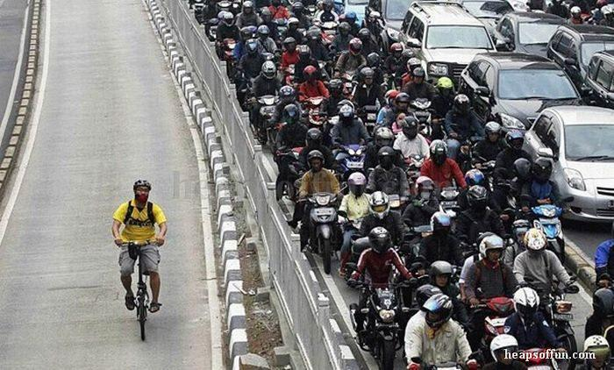
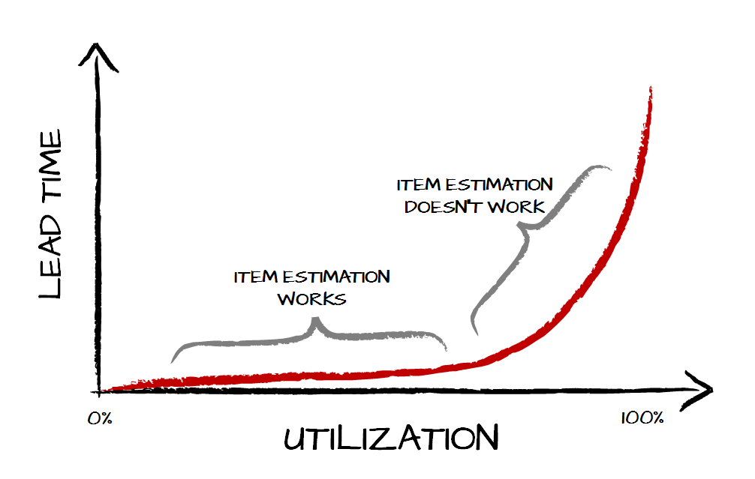
Root of All Fails: High System Utilization
Forecasting
How Big
How Long
How Much
Fails
Q and A
Can’t forecast high utilization systems using item size…

Slide 18
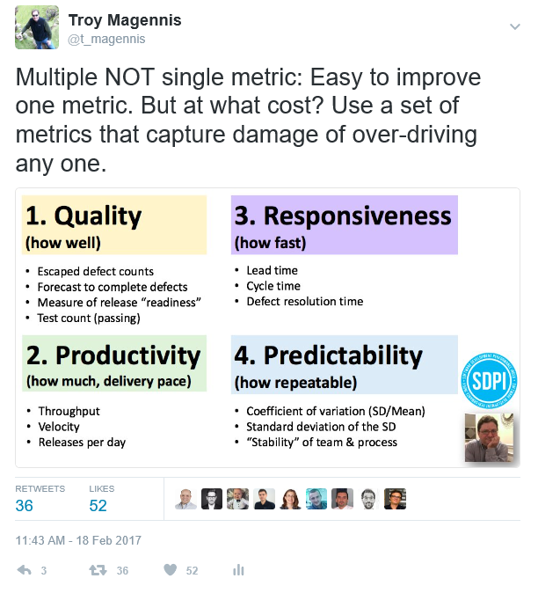

Slide 19
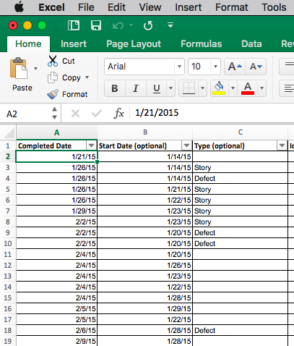
Notes:
Here is the input page. Completed date is mandatory. Start date is optional but well advised. And the type of work. Is it planned or un-planned work is needed to see how these different types stack up. This is optional. Most people don’t use it, I’ll leave that up to you.

Slide 20
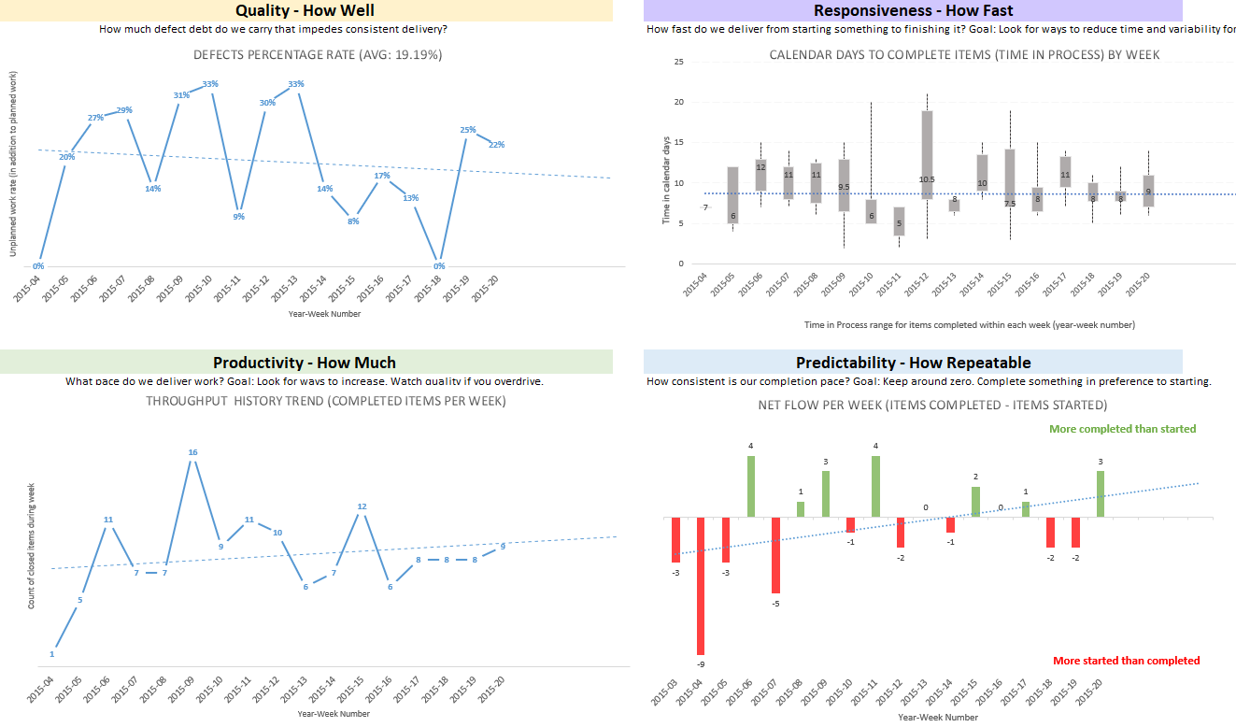
Team Dashboard v3.xlsx spreadsheet Bit.Ly/SimResources

Slide 21
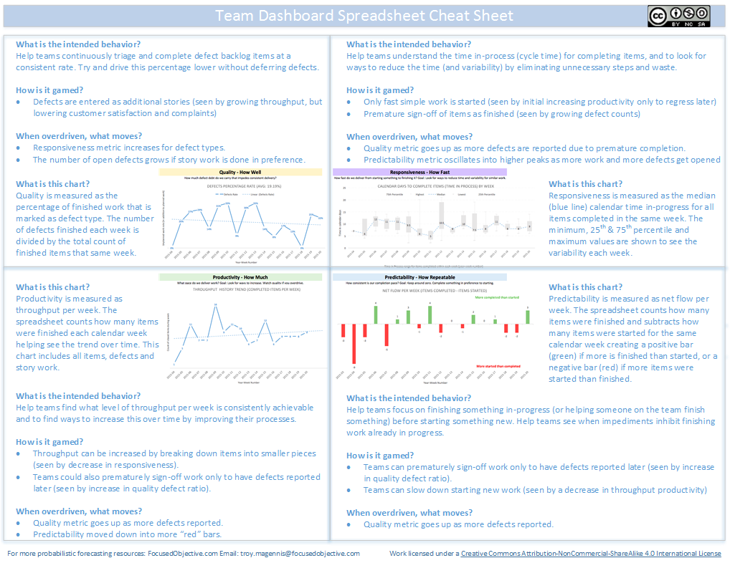
Team Dashboard v3.xlsx spreadsheet Bit.Ly/SimResources
Balancing Metric

Slide 22
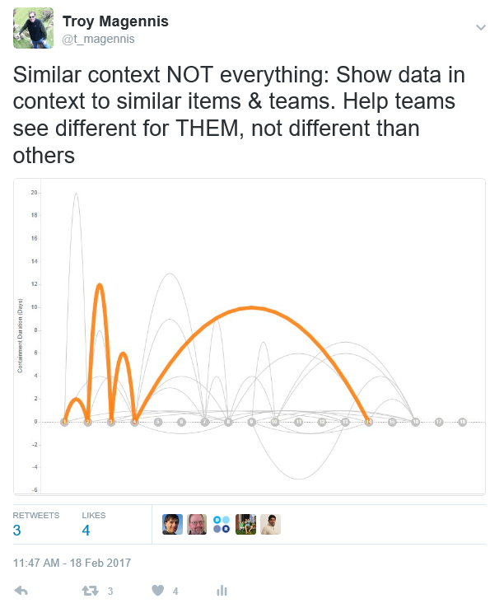

Slide 23
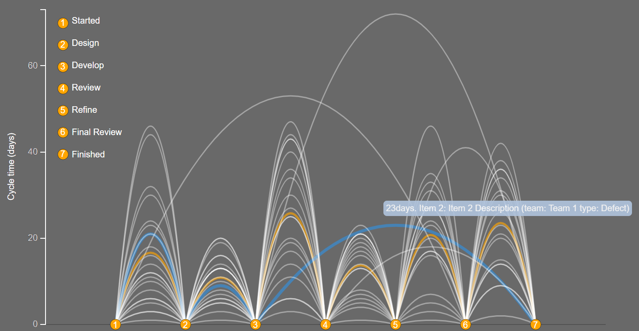
http://Bit.ly/SimResources Spreadsheets/Jump-plot.xlsm

Slide 24
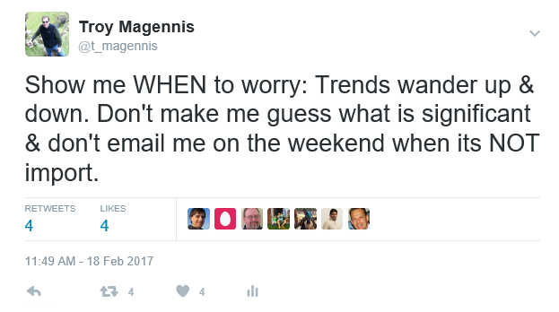

Slide 25
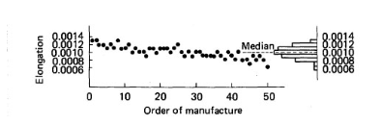
Q. Is the process stable? First, do no harm.
“If anyone adjusts a stable process, the output that follows will be worse than if (s)he had left the process alone” Attributed to William J Latzko. Source: Out of the Crisis. Deming.
Notes:
Edward Deming has published many books about his work in managing manufacturing processes, in his book “Out of the Crisis” he goes to good lengths to discuss that when looking at a process, your first job is to do no harm. If the process is “in-control” leave it alone! Touching it causes things to likely get worse. A graphic caught our eye. It is a run chart showing spring manufacturing data. Each dot represented a tested spring, and a downward trend can be seen even though the variation shown by the marginal histogram looks perfectly symetrical. In Deming’s words, you can assess a process unless you can see the change over time and the distribution of variation. The scatter plot alone isn’t enough. The histogram of frequency of result isn’t enough. You need both.

Slide 26
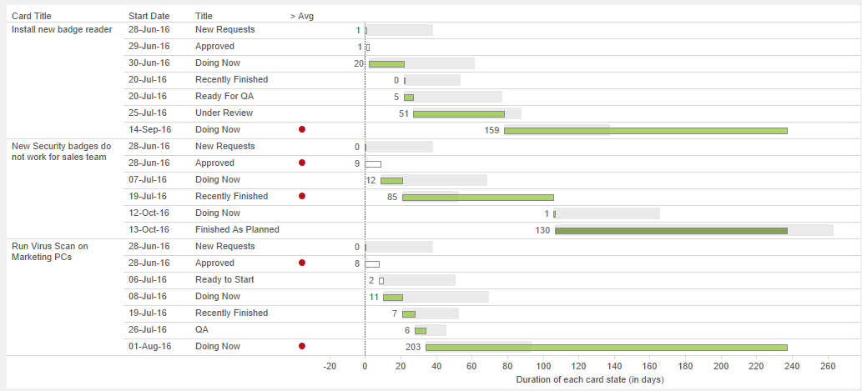
Why add the average bar? So you have a “Compared To” reference
Average for lane
Time for this card
“Look at me” dot
Why add the look at me dot? Quickly draw your eye to know anomalies

Slide 27
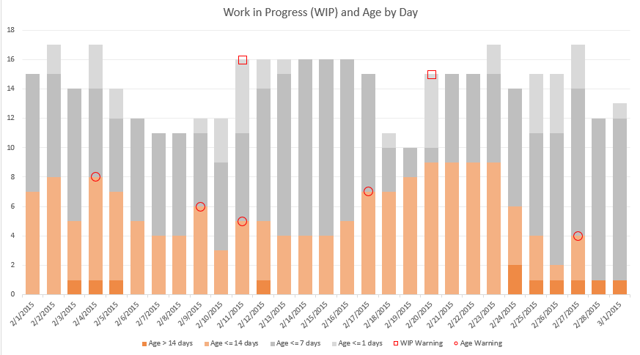

Slide 28
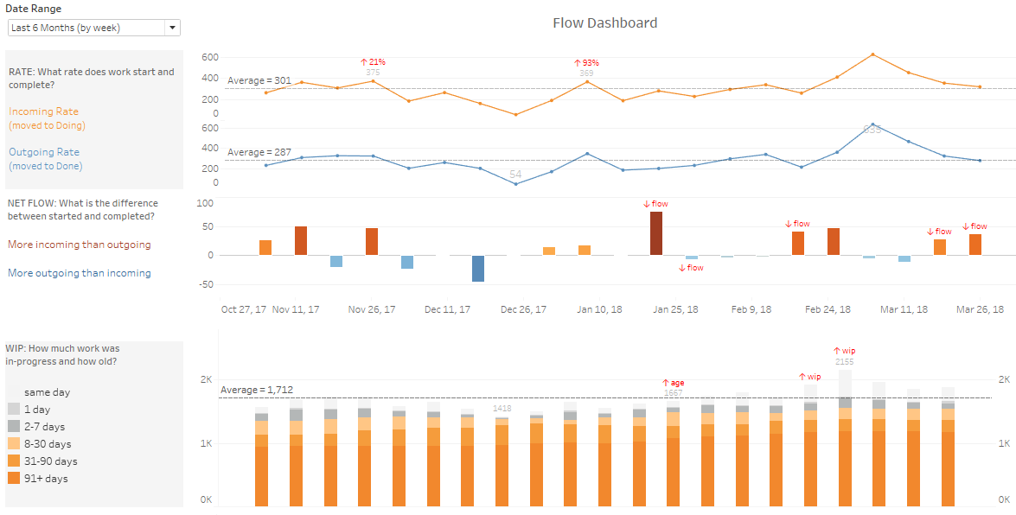

Slide 30
http://Bit.Ly/SimResources
@t_magennis

Slide 31
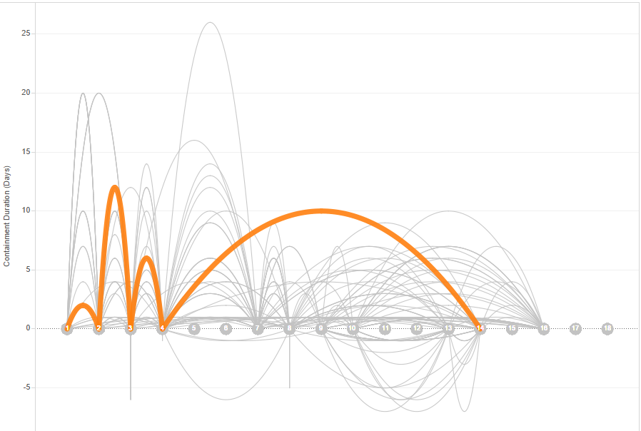
Why did this jump all of those steps? Turns out it was a production issue that was expedited into deployment.

